Slide 1

R19IT251 - Software Engineering
Module I – Software Process Model

Slide 2
Contents
SDLC and SDLC Models
Agile Development Models
Extreme Programming
Feature Driven Development
Kanban – project management
Lean Software Development
DevOps and benefits

Slide 3

Software Engineering Layers

Slide 4
SOFTWARE PROCESS MODELS
Process
Task
Action
Activity

Slide 5

SOFTWARE PROCESS MODELS
Software Framework
Foundation for a complete software engineering
process
Framework Activities
Communication
Planning
Modeling
Construction,
Deployment

Slide 6

SOFTWARE PROCESS MODELS
Activities that complicates the framework activities
Umbrella Activities
Software project tracking and control
Risk management
Software quality assurance
Technical reviews
Measurement
Software configuration management
Reusability management
Work product preparation and production

Slide 7
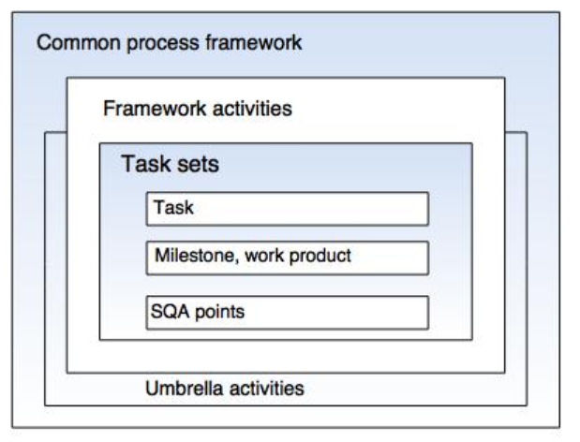
SOFTWARE PROCESS MODELS

Slide 8
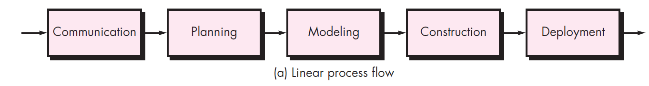
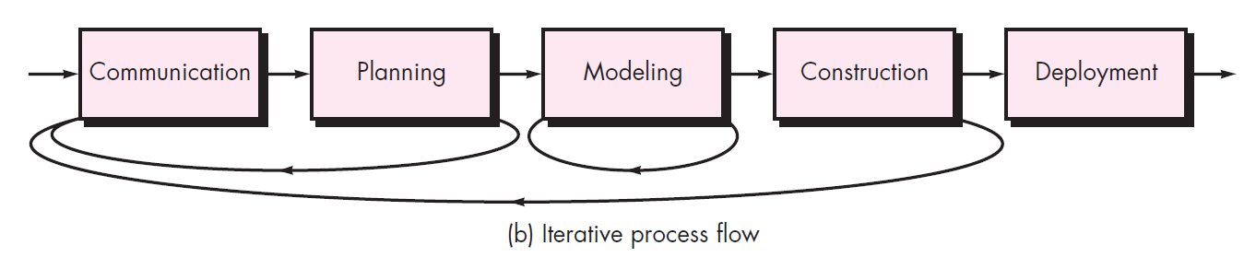
SOFTWARE PROCESS MODELS

Slide 9
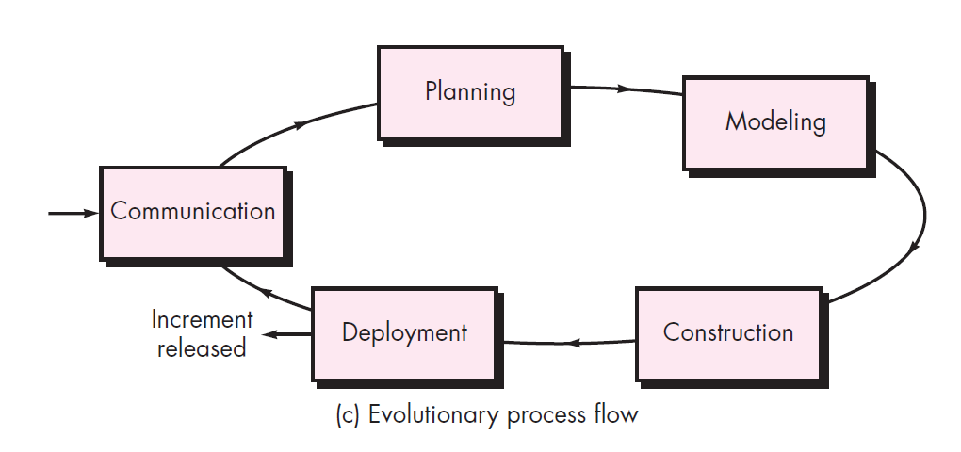
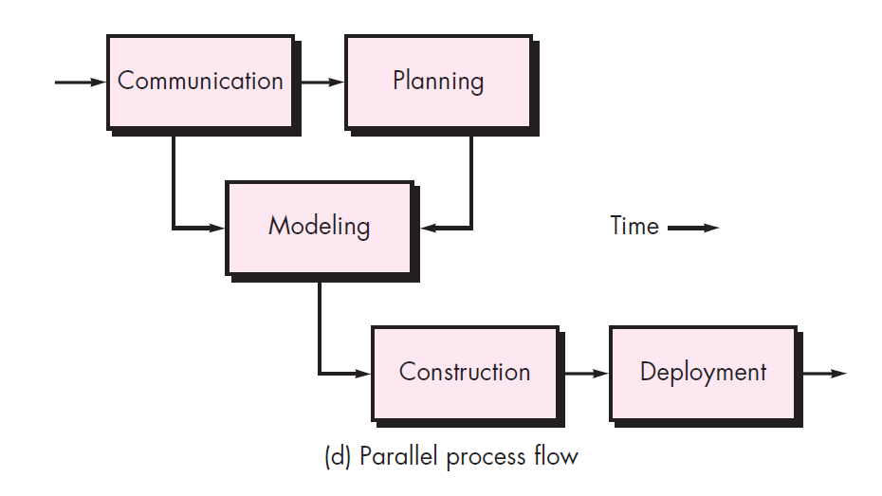
SOFTWARE PROCESS MODELS

Slide 10
SOFTWARE PROCESS MODELS
Setting a Task
1. Make a list of stakeholders for the project.
2. Invite all stakeholders to an informal meeting.
3. Ask each stakeholder to make a list of features and functions required.
4. Discuss requirements and build a final list.
5. Prioritize requirements.
6. Note areas of uncertainty.

Slide 11
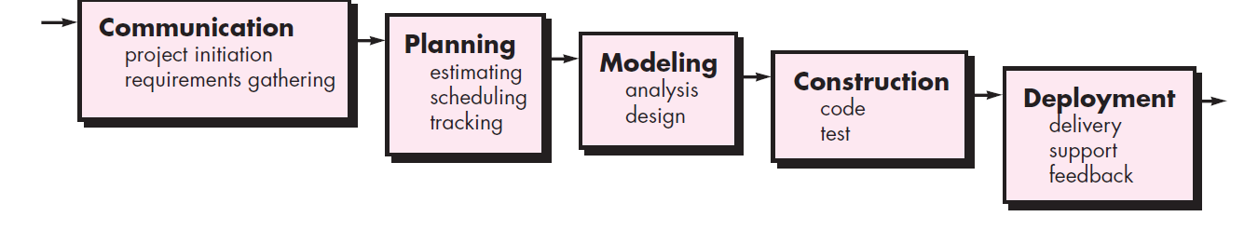
SOFTWARE PROCESS MODELS
The waterfall model

Slide 12
SOFTWARE PROCESS MODELS
The waterfall model
Short-term projects
Clear, fixed, and well-documented requirements
Static technology that is understood
Stable product definition
A variety of resources for product support
Low Product Owner Involvement
Strictly-set timeline
Fixed budget that cannot be changed

Slide 13
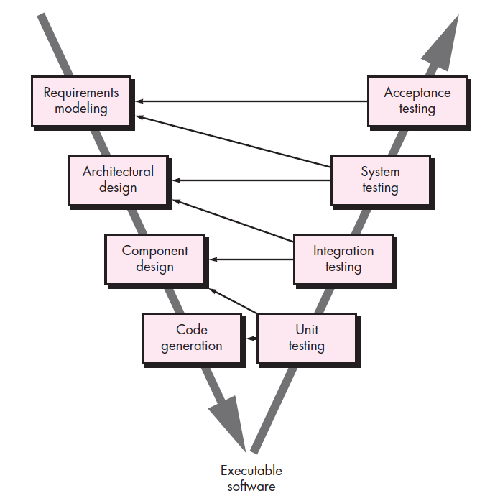
SOFTWARE PROCESS MODELS
The V model

Slide 14
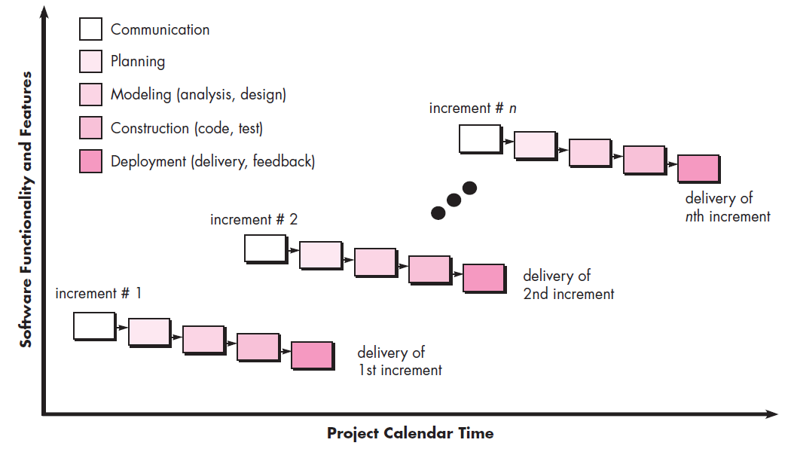
SOFTWARE PROCESS MODELS
The Incremental Method

Slide 15
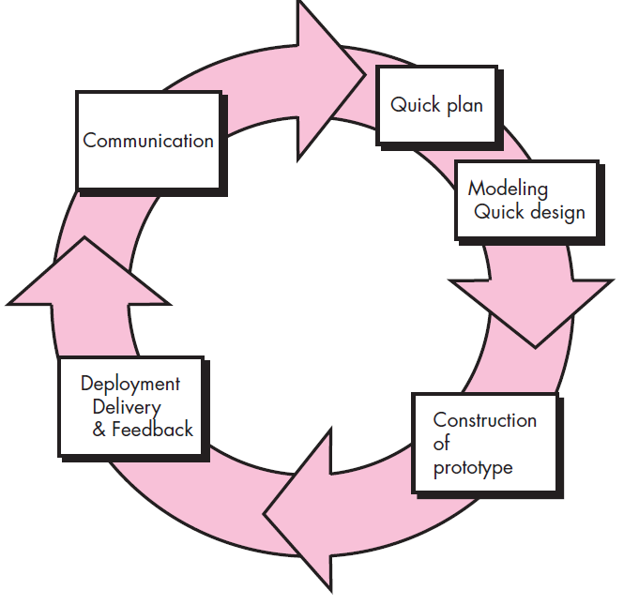
SOFTWARE PROCESS MODELS
The Prototyping Paradigm

Slide 16
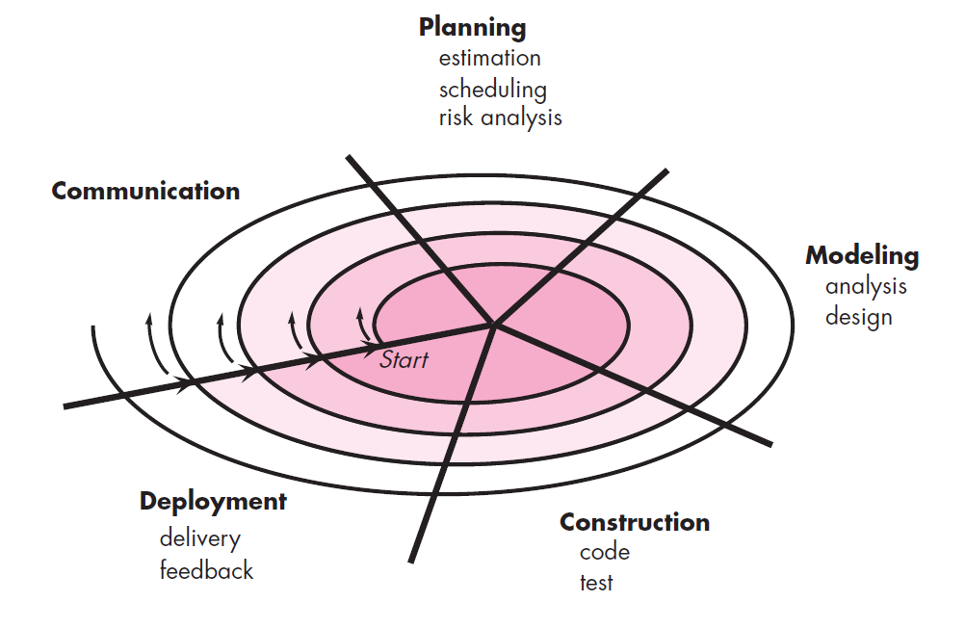
SOFTWARE PROCESS MODELS
The Spiral Model

Slide 17
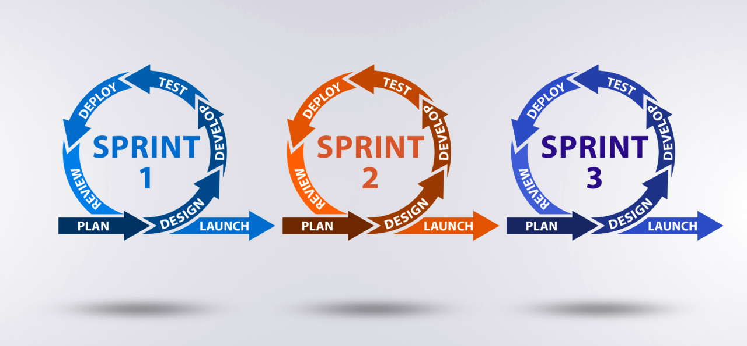
SOFTWARE PROCESS MODELS
Agile Methodology

Slide 18
SOFTWARE PROCESS MODELS
Agility Principles
Satisfy the customer through early and continuous delivery of valuable software
Welcome changing requirements, even late in development
Deliver working software frequently, from a couple of weeks to a couple of months, with a preference to the shorter timescale
Business people and developers must work together daily throughout the project.
Working software is the primary measure of progress
Agile processes promote sustainable development.
At regular intervals, the team reflects on how to become more effective, then tunes and adjusts its behavior accordingly.

Slide 19
Introduction to AGILE:
AGILE methodology is a practice that promotes continuous iteration of development and testing throughout the software development lifecycle of the project.
Agile is the ability to create and respond to change.
It is a way of dealing with, and ultimately succeeding in, an uncertain and unstable environment.
In the Agile model, both development and testing activities are concurrent, unlike the Waterfall model.
The Agile Manifesto was created during a meeting in February 2001 that brought together a number of software and methodology experts who were at the forefront of the emerging agile methods.

Slide 20
Manifesto for Agile Software Development
We are uncovering better ways of developing software by doing it and helping others do it. Through this work we have come to value:
Individuals and interactions over processes and tools Working software over comprehensive documentation Customer collaboration over contract negotiation Responding to change over following a plan
That is, while there is value in the items on the right, we value the items on the left more.

Slide 21
AGILE Values:
Value 1 – Individuals and Interactions over processes and tools
Value 2 – Working software over comprehensive documentation
Value 3 – Customer collaboration over contract negotiation
Value 4 – Responding to change over following a plan

Slide 22
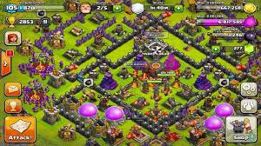
SOFTWARE PROCESS MODELS

Slide 23
SOFTWARE PROCESS MODELS
SCRUM
Definition:
Scrum emphasizes the use of a set of software process patterns that have proven effective for projects with tight timelines, changing requirements, and business criticality.
Backlog—a prioritized list of project requirements
Sprints—consist of work units that are required to achieve a requirement defined in the backlog that must be fit into a predefined time-box

Slide 24
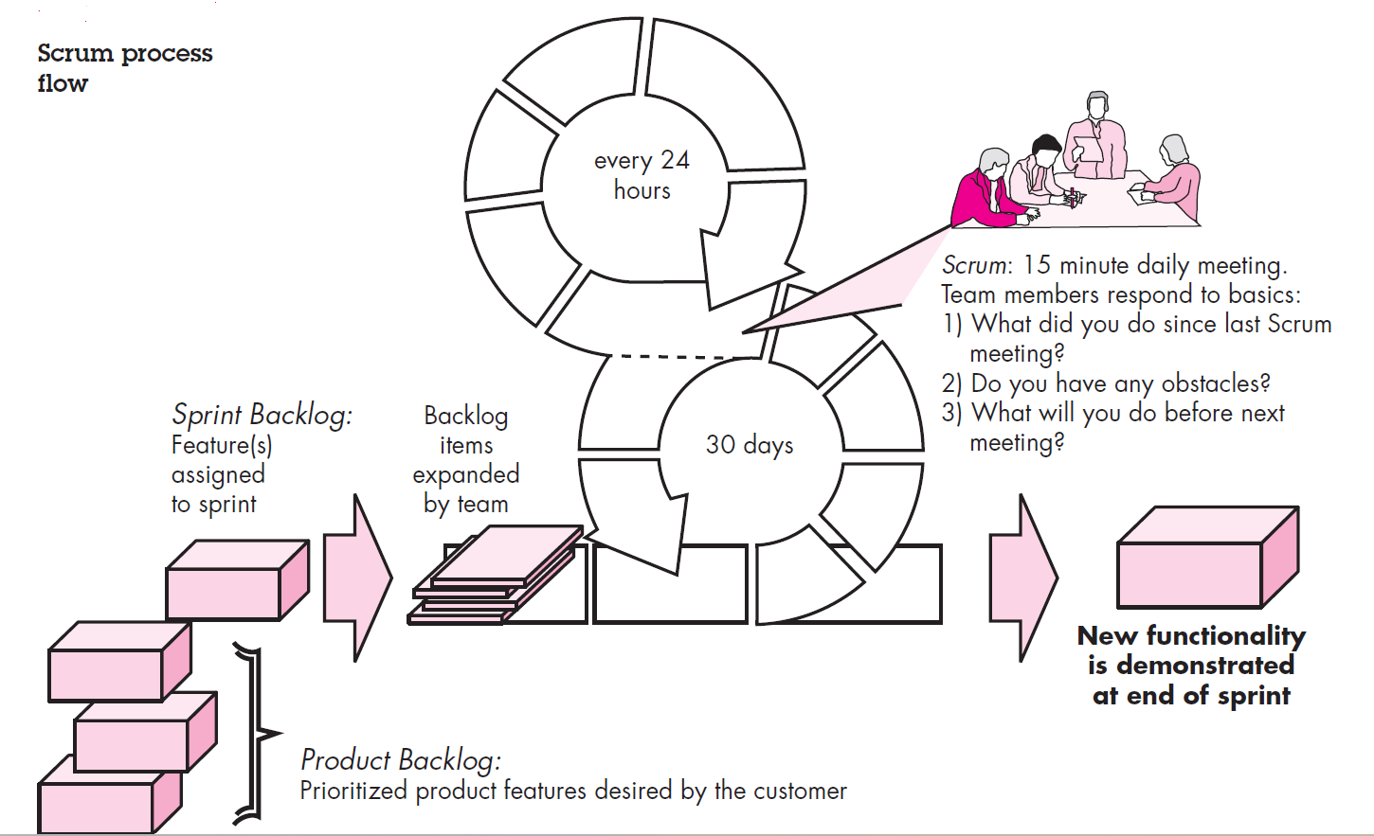

Slide 25
SOFTWARE PROCESS MODELS
Scrum meetings—are short (typically 15 minutes) meetings held daily by the Scrum team.
Three key questions are asked and answered by all team members:
• What did you do since the last team meeting?
• What obstacles are you encountering?
• What do you plan to accomplish by the next team meeting?
A project manager, called a Scrum master
Demos—deliver the software increment to the customer

Slide 26
SOFTWARE PROCESS MODELS
Scrum helps people and teams deliver value incrementally in a collaborative way.
As an agile framework, Scrum provides just enough structure for people and teams to integrate
how they work, while adding the right practices to optimize for their specific needs.

Slide 27
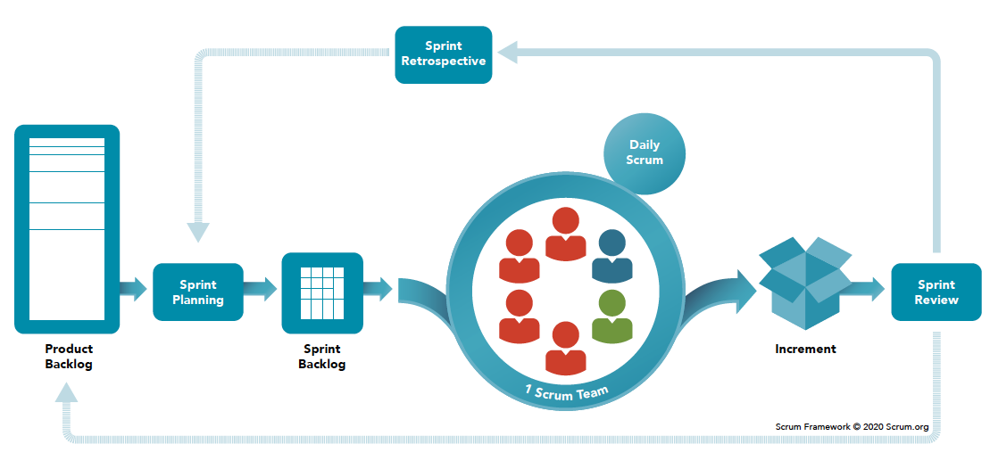
SOFTWARE PROCESS MODELS

Slide 28
SOFTWARE PROCESS MODELS
Scrum Roles
Scrum Team consists of a Product Owner, a Scrum Master and Developers

Slide 29
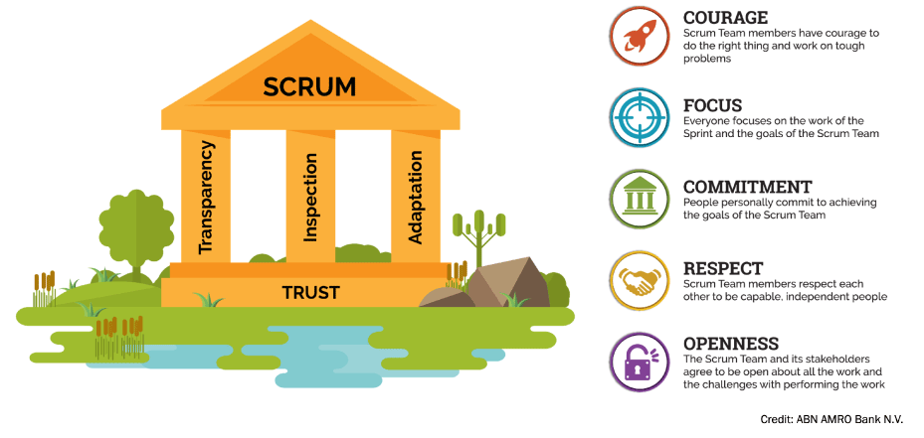
SOFTWARE PROCESS MODELS

Slide 30
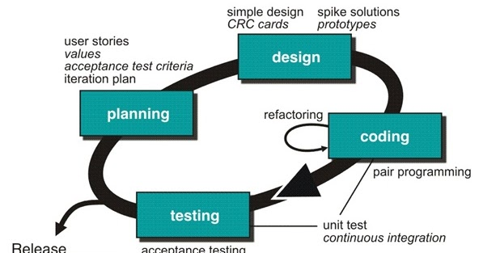
SOFTWARE PROCESS MODELS
EXTREME PROGRAMMING (XP)
Approach used in Agile Methodology

Slide 31
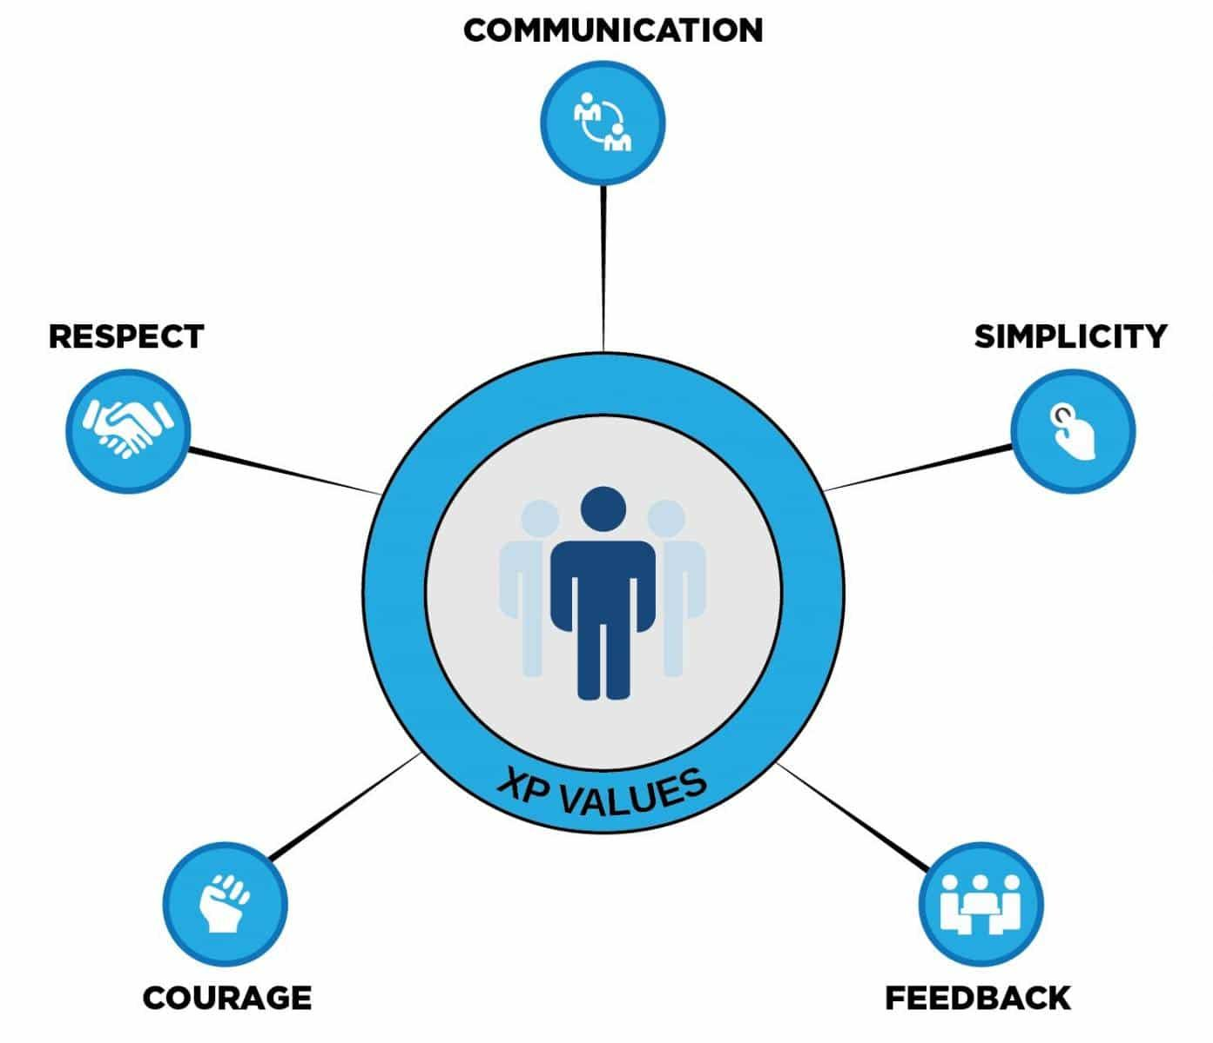
SOFTWARE PROCESS MODELS

Slide 32
SOFTWARE PROCESS MODELS
Extreme programming application happens in the projects where the requirements keep on changing.
In some critical projects, even before starting the project, the timelines are decided. It is referred to as project risk as it is challenging to meet those timelines.
Extreme programming also addresses the project risk by frequent and shorter development cycles and consequently enabling early feedback.
XP gets applied where we have a small group of programmers, not more than 12.

Slide 33
SOFTWARE PROCESS MODELS
Continuous feedback helps you understand how great you are doing.
Customer
System
Within the team

Slide 34
SOFTWARE PROCESS MODELS
The below principles get applied during the entire procedure of Extreme Programming:-
1. Rapid feedback
2. Assume Simplicity
3. Incremental change
Small changes in the plan
Minute changes in a team
Small changes in the design
4. Embracing change
5. Quality work
Work as a team
Enjoy their roles
Should be supportive
Should feel good and focused on delivering a quality product

Slide 35
SOFTWARE PROCESS MODELS
Feature Driven Development (FDD)
FDD adopts a philosophy
emphasizes collaboration among people on an FDD team
(2) manages problem and project complexity using feature-based decomposition followed by the integration of software increments
(3) communication of technical detail using verbal, graphical, and text-based means.
FDD emphasizes software quality assurance activities by encouraging an incremental development strategy, the use of design and code inspections, the application of software quality assurance audits, the collection of metrics, and the use of patterns

Slide 36
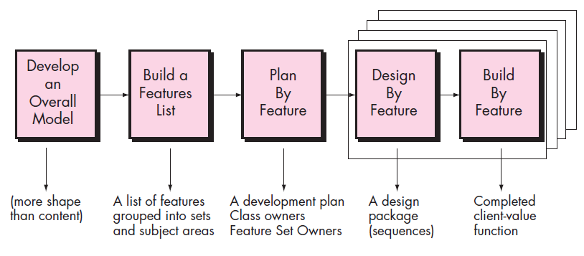
SOFTWARE PROCESS MODELS

Slide 37
SOFTWARE PROCESS MODELS
Kanban
Kanban is a popular framework used to implement agile and DevOps
Software development.
It requires real-time communication of capacity and full transparency of work.
Work items are represented visually on a kanban board, allowing team members to see the state of every piece of work at any time.

Slide 38
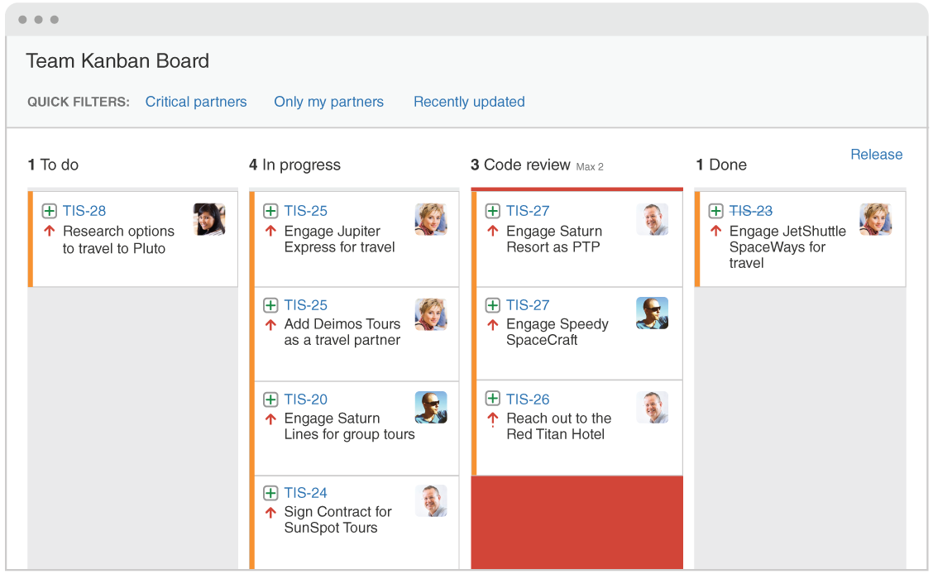
SOFTWARE PROCESS MODELS

Slide 39
SOFTWARE PROCESS MODELS
 | SCRUM | KANBAN
Cadence | Regular fixed length sprints (ie, 2 weeks) | Continuous flow
Release methodology | At the end of each sprint if approved by the product owner | Continuous delivery or at the team's discretion
Roles | Product owner, scrum master, development team | No existing roles. Some teams enlist the help of an agile coach.
Key metrics | Velocity | Cycle time
Change philosophy | Teams should strive to not make changes to the sprint forecast during the sprint. Doing so compromises learnings around estimation. | Change can happen at any time

Slide 40
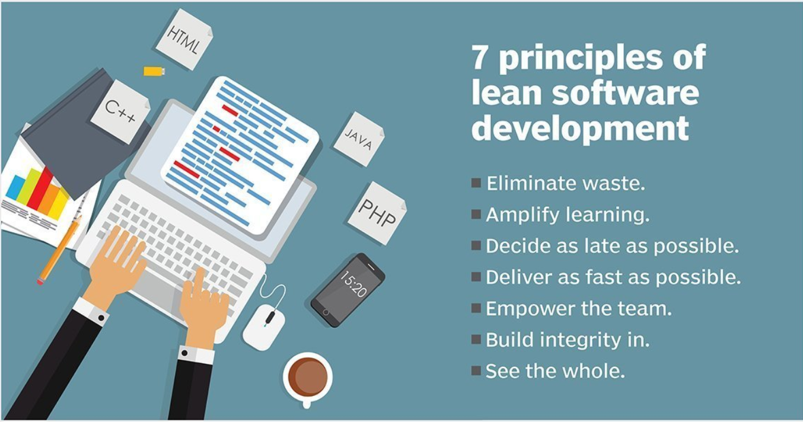
SOFTWARE PROCESS MODELS

Slide 41
SOFTWARE PROCESS MODELS
DEVOPS ?

